Slide 1
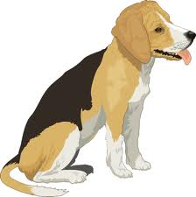
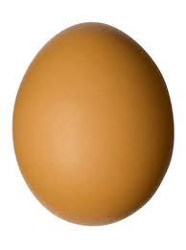
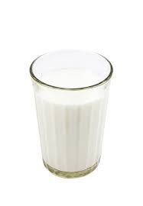
Extracting Semantic Knowledge from Wikipedia Category Names
Priya Radhakrishnan and Vasudeva Varma
(priya.r@research.iiit.ac.in; vv@iiit.ac.in)
AKBC workshop at CIKM 2013
A I M
35
Extract meaningful content from semi structured knowledge bases using semantic features
Introduction
Semantic features are features that indicate semantic relatedness between word-tokens
Semantic relatedness is a measure of likeness in meaning between two word-tokens
We present six semantic features and demonstrate them in a web query completion task.
Semantic Relatedness scale from Wikepedia Category Network
A P P R O A C H
35
Domesticated Animals
Pet Animals
Cosmopolitan Species
NounPhrase IN
NNS IN NNS NNP IN NN
Films about cats Cats in art
films_cats films_art cats_art
Goat
Camel
Dog
Cat
Ferret
Mouse
Wikipedia Category Network – A network of category nodes,
with edges showing relatedness.
for each category node do
representation <- #articles
similarity <- #sibling categories
popularity <- position of category in the child article’s category list.
normalize for category
normalize for category pair
done
return Normalized Representation(NR), Similarity,
Relative Popularity(RP), Leftness
Category names followed the POS tag pattern NounPhrase(IN NounPhrase)+
E V A L U A T I ON
Dataset
Wikipedia Category Names and article titles.
Only the names of leaf categories and categories sharing an article, was used.
Results
We see correlation coefficient improve from 0.40 to 0.66.
Correlation of SR score with human judgments
Experiments
Experiment conducted with standard SR evaluation datasets(WS353, TSA287).
for each word pair ε dataset do
SR0 <- SR score(word pair) using WordNet based measure.
SR1 <- SR0 + SR score(word pair) using the six semantic features.
correlate SR1 with human judgment score
done
return correlation of the SR score with human judgment
Phase | WS353 | TSA287
WordNet | 0.37 | 0.40
WordNet + NR1 | 0.57 | 0.51
WordNet + Similarity | 0.57 | 0.48
WordNet + Leftness | 0.55 | 0.49
WordNet + NR2 | 0.44 | 0.66
WordNet + RP | 0.21 | 0.37
A P P L I C A T I O N – Query Completion
Query Completion prediction results
Method | SR | MRR
P(f/e) | 0.0937 | 0.0316
P(f/C) with NR1 | 0.0083 | 0.0083
P(f/C) with Similarity | 0.0100 | 0.0050
P(f/C) with Leftness | 0.0450 | 0.0004
What is the best completion(f) for the given entity query string(e)?
State of the art : frequency of f for a given e in query logs, P(f/e).
Improvement : frequency of f for a given entity’s category P(f/C), augmented with Semantic features.
The results follow a pattern similar to that of original experiments.
N O V E L T Y – Lesser Data Processing
Other Applications Tag Suggestion & Tag Relatedness computing
Search and Information Extraction Lab,
Language Technology Research Centre, IIIT-Hyderabad
http://search.iiit.ac.in

