Slide 1
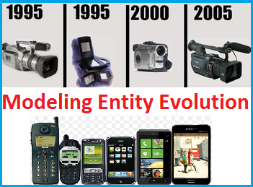
Modeling the Evolution of Product Entities Priya Radhakrishnan¹, Manish Gupta^{1,2}, Vasudeva Varma¹ ¹Search and Information Extraction Lab, IIIT-Hyderabad, India ²Microsoft, Hyderabad, India
July 9, 2014
ACM
SIGIR 2014
July 6-11, 2014
The 37th Annual International ACM SIGIR Conference
priya.r@research.iiit.ac.in, gmanish@microsoft.com, vv@iiit.ac.in

Slide 2
Motivation
Predict the previous version (predecessor) of a product entity
Link various versions of a product in a temporal order
Windows 7.0 > Windows 8.0
Helps study evolution of product entities
Ubuntu 4.10 > Ubuntu 5.04 > Ubuntu 5.10 > Ubuntu 6.06
Install CD > USB > LiveCD
Finding the predecessor of a product entity is the first step towards modeling the Evolution of Product Entities

Slide 3
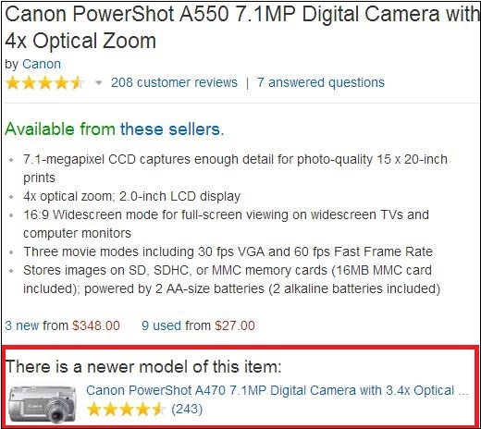
A Typical Product Listing on Amazon

Slide 4
Challenges
Deceptively easy task
No common naming convention for versions or products
Windows (3.0 > 95 > 98 > 2000 > XP > 7.0 > 8.0)
Ubuntu (Warty > Hoary > Breezy > Dapper > Edgy )
Product mentions occur in unstructured natural language form
“JVC S-VHS Camcorder”, “Super VHS Camcorder”, “S VHS Camcorder”

Slide 5
Proposed Approach
Two stage approach
Stage 1: Given a set of product entity names, we parse the product names to identify the brand, product and version indicating words from the product name
Stage 2: Cluster products based on brand and product. Within a cluster, rank the version(s) in temporal order

Slide 6
A Two Stage Approach
Stage 1
Input
Output
Leica D-Lux 6 digital camera
Leica
D-Lux
6
digital camera
Stage 2
Leica
Leica D-Lux 6 digital camera
Leica D-Lux 4 digital camera
Digital camera Leica D-Lux 5
D-Lux
4
5
6
Canon
Canon A630
Canon A640
A630
A640

Slide 7
Stage 1 – Parsing the Product Title (1)
Categorizing words in the product title as brand, product, version and other
Conditional Random Fields (CRF) based approach
CRF tagger is trained on manually labeled (word, label) pairs using 3 features
Product description
Context patterns surrounding the labels
Linguistic patterns frequently associated with the labels
Label words in product titles from the test set
Given any query product version, we identify its (brand, product)
Group together product entities that have the same brand and product as the given query

Slide 8
Stage 1 – Parsing the Product Title (2)
Feature Set
Product description
Description, weight, review, model, category, URL
Context patterns
Position of the word title, alphabet, numeral, parenthesis, previous word
Linguistic patterns
Words of the product title have POS tag (NNP, MD, VB, JJ, NN, CD, NNS, IN, RB, DT, VBP, VBD, CC, VBN, JJS, VBZ, LS, VBG, FW, PRP$, PRP, SYM)

Slide 9
Stage 2 – Predicting Predecessor Version
Members of a set of product entities with the same brand name and product name are candidates for being Predecessor version of query entity’s version
Classification based approach
Binary features on Ordering
Lexical : Does the candidate lexically precede the given query product version?
Review-Date : Is the candidate older than the given query product version based on review date?
Mentions : Was the candidate mentioned in the query product versions description or reviews?
Nokia Lumia 1020 precedes Nokia Lumia 1320 by Lexical and Review-date features

Slide 10
Dataset
Crawled 462K product description pages from www.amazon.com
Labeled 500 from “camera and photo” category
40 out of the 500 product titles had predecessor version

Slide 11
Results – Stage 1
Parsing the product title
CRF Accuracy for the Product Title Parsing Task
Label | P | R | F
Brand name | 0.98 | 0.65 | 0.77
Product name | 0.89 | 0.58 | 0.69
Version | 0.69 | 0.48 | 0.55
Product name/Version | 0.88 | 0.55 | 0.67
Others | 0.84 | 0.98 | 0.91

Slide 12
Results – Stage 2
Predicting the Predecessor Version
Classifier Accuracy for the Positive Class for Product Predecessor Version
Prediction
Feature | TP | FP | P | R | F
Lexical + Review- Date | 0.632 | 0.049 | 0.533 | 0.632 | 0.578
All Features | 0.579 | 0.049 | 0.512 | 0.579 | 0.543
Review-Date | 0.579 | 0.061 | 0.458 | 0.579 | 0.512
Review-Date + Mentions | 0.553 | 0.047 | 0.512 | 0.553 | 0.532
Lexical + Mentions | 0.5 | 0.049 | 0.475 | 0.5 | 0.487
Lexical | 0.5 | 0.056 | 0.442 | 0.5 | 0.469
Mentions | 0.45 | 0.049 | 0.462 | 0.45 | 0.456

Slide 13
Related Work
Extracting attribute values for product entities
Mauge, Karin et al. Structuring E-Commerce Inventory. ACL ’12
Putthividhya, Duangmanee et al. Bootstrapped Named Entity Recognition for Product Attribute Extraction. EMNLP ’11
Identifying related entities
N. Bach and S. Badaskar. A Survey on Relation Extraction LTI CMU 2007
L. Fang, A. D. Sarma, C. Yu, and P. Bohannon. REX: Explaining Relationships Between Entity Pairs. PVLDB, 5(3):241252, Nov 2011
None of the above works focus on extracting the version information from the product listing titles, which we have accomplished in the proposed work

Slide 14
Conclusion
A two-stage approach to find the predecessor of a product entity
First stage achieved a precision of ~88%
Second stage achieved a precision of ~53%
Applications
Product search engine ranking
Comparing product versions

Slide 15
Future Directions
We plan to enhance this work as follows
For building product version trees
Studying how features of product entities evolve
Code
https://github.com/priyaradhakrishnan0/EntityRanking
Golden dataset
IIIT-H Internal Link
http://10.2.4.116/backup/sieldata/datasets/EntityRanking/data.zip
External Link
http://tinyurl.com/lclapy8

Slide 16
Thank you for your time and attention

